Slide 1

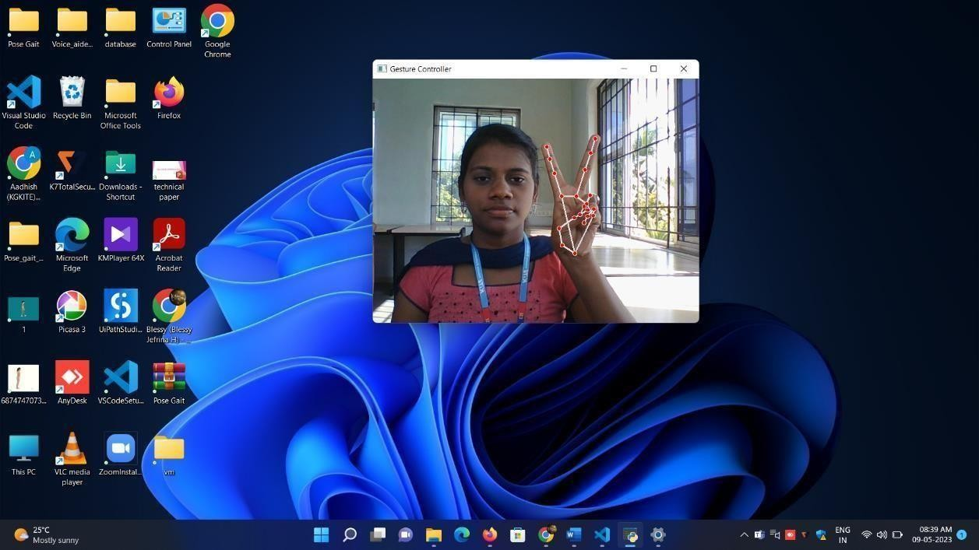
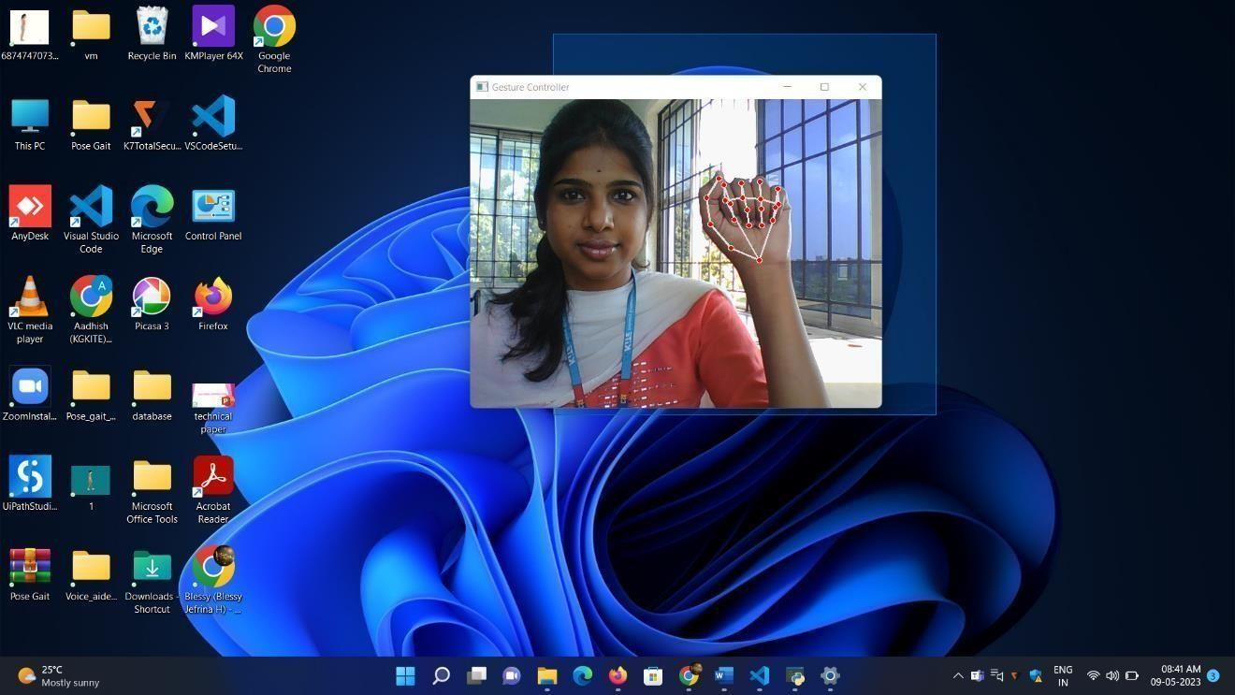
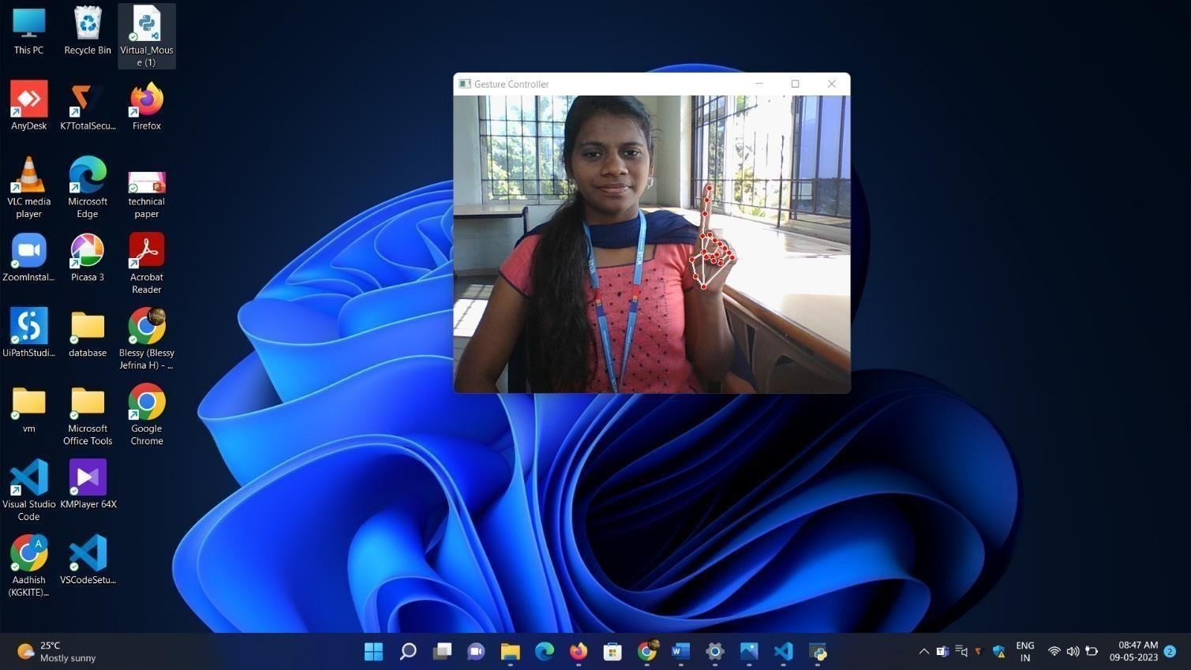
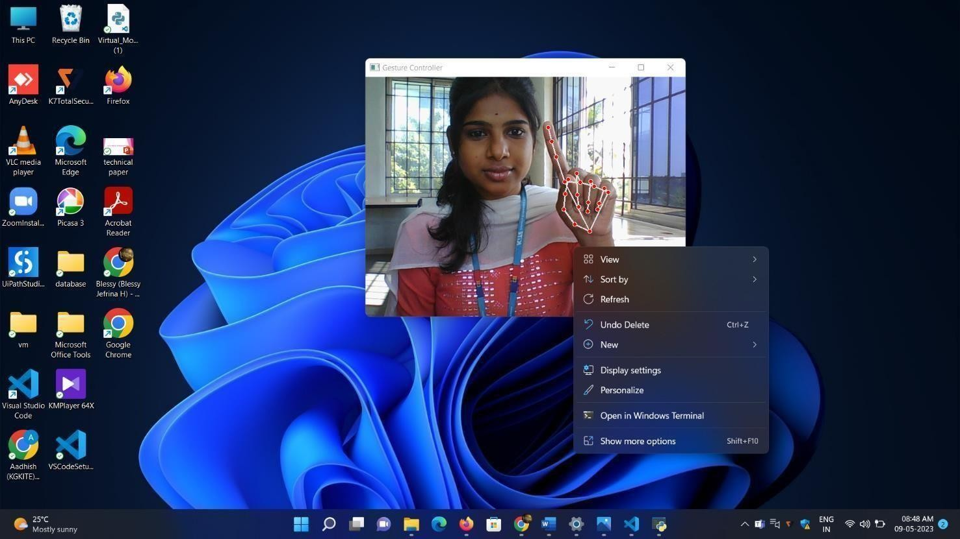
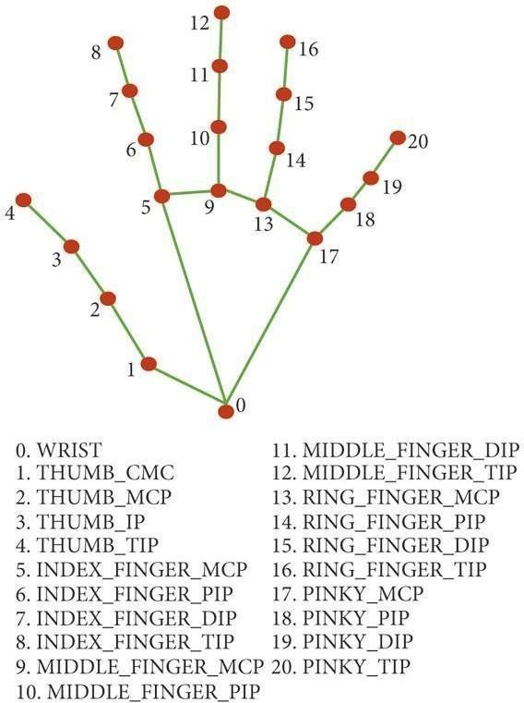
VIRTUAL MOUSE ON CURSOR MOVEMENT BY OBJECT MOTION
Introduction
Results
The virtual mouse on cursor movement by object motion is an exciting development in the field of human-computer interaction, offering users a highly intuitive and efficient input method that can improve accessibility and enhance productivity. The virtual mouse on cursor movement by object motion is a highly intuitive and user-friendly input method that offers a range of benefits.
This symbol indicates that a handheld hardware input device that controls a cursor in a GUI for pointing, moving, and selecting the text, icons, files, and folders on your computer. The symbol is used to act as a left click. It selects an item in a graphical user interface by pressing the left-hand button of a mouse, The left click is used to click, select, and drag to highlight a word and/or object and is used as a pointer.
Displaying output
Motivation
This system is to perform computer mouse cursor functions and scroll function using a web camera or a built-in camera in the computer instead of using a traditional mouse device. Hand gesture and hand tip detection by using computer vision is used as a HCI with the computer.
SCOPE of the Project
The scope of this project included :
Highly intuitive and user-friendly input method.
Helpful for individuals with disabilities .
Advanced image recognition and motion tracking algorithms.
Methodology
The following steps are included to develop the algorithm: -
● The first step is to capture the image using the camera.
● The camera then extracts and recognizes the human hand from the input
image.
● Then the position of the human hand is stored in the system using the
regular” coordinate system”.
● Then when the second frame is captured. The position of the hand from the
second frame is captured and stored in the system.
● Then the position of both hands is compared and then the cursor moves
accordingly.
● Now for the system of clicking the angle between the two hands of the
finger is measured and if the angle is less than 15 degrees the system responds
to itas a left click. In this way, the complete working of the mouse can be done
with bare hands.
For moving the cursor the first step is to find the middle of the hand which
can be determined using the following command..
Co-ordinates or land marks in the hand
System Architecture
Conclusion
Virtual mouse on cursor movement by object motion can conclude by using the topics of computer vision like open CV, it can form masks that can differentiate colors by using color variation techniques and also development of mouse movement by using certain packages like ‘mouse’ which will be used for the movement of mouse by using the coordinates that are linked to the detected color.
References
[1] Amardip Ghodichor, Binitha Chirakattu “Virtual Mouse using Hand
Gesture and Color Detection”, Volume 128 – No.11, October 2015.
[2] Shahid Chhoriya P., Paliwal G., Badhan P., 2013, “Image Processing
Based Color Detection”, International Journal of Emerging Technology and
Advanced Engineering, Volume 3, Issue 4, pp. 410-415.

